Slide 1
Engineering design PROJECT
Group-10

Slide 2
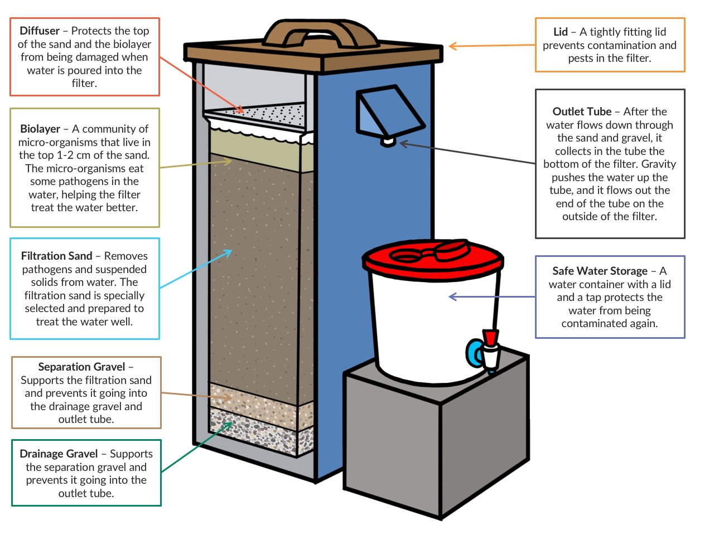
HOUSEHOLD WATER TREATMENT USING BIO SAND WATER FILTER
Affordable
High removal of pathogens
One time installation
Low maintenance
Easy to operate

Slide 3
What’s the need?
In India, specially in villages there have been a large number of deaths owing to jaundice. Other water-borne diseases like typhoid, jaundice, and gastroenteritis are also rampant. The primary reason is the lack of clean drinking water. To address the issue we need a low-cost filtration equipment.
We have to evaluated the technologies available for their cost, ease of use and sustainability.
Inexpensive and effective filters developed especially for deployment in remote areas.

Slide 4
STAGES | Specialist skills required | Examples, activities and tools | Risk level and handling | Finance required | Kinds of evidence generated | Goal
Exploring opportunities & challenges | Research, water purification technology | Material and hardware tools | Moderate risk level, Proper planning and techniques | Minimum funds. | Public health, high cost water filters | Having a basic structure or design
Generating ideas | Communicating new ideas, ideation of creative thinking. | Conducting educative workshop for the people , open to new ideas. | High risk, a small mistake can lead to big consequences. | It should be low budget. | Simple amount of improvement for potential explanation, aided but not extremely limited by data. | Development of a single idea or a group of ideas for testing.
Developing & testing | Thinking in an innovative manner and implementing it | Using all the ideas appropriately | High risk, even a small mistake can lead to big consequences. Should be ready to correct any mistake efficiently | Funds for the project. | Testing the developed model so that it works accurately | To make a model which works accurately and effectively without any loss
Making the case | To observe the competitors and competition in our market and analysing through it. | Competitors companies and chief analysts to observe and analyse them. | No risk level. | Small part of fund should be spend. | Analysed reports and data . | To better observe our competitors and find flaws in our systems.
Delivering & implementing | Strong leadership and management skills , delivery and implementing skills with patience. | Target audience, critical task list . | Should be ready for some adaptation to implementation | Funds for the project . And funding from seed investors. | A comprehensive and thorough argument formed by systematic review and collection of facts . Usage of project once on a test group to distinguish effects . | An implemented and sustainable innovation.
Growing, scaling & spreading | Management skills Fund distribution and prioritizing your products, cities and areas . | Appropriate data of villages. Data of time to time services. Technical Problems solved data | As risk is always there. We should focus on those areas where selling could be more. At this stage we can tie up from different tech companies . For our increase in production. | Seed investment from the companies and angel investors . Then, it should open for all to invest as a (share per price) Funds should be distributed wisely in areas acc. To the scaling of products. | Reports and data of selling the products. We will get to know about our next target from this type of data. | Product and services should have maximum reach. and it should be the best .costumers must not have any complain issue and if it does we will solve it or send our team.
Changing systems | Technical team and technical skills. | New technology. which Is sustainable too.. And with better 0 emissions and less electricity or mechanical intake. | High risk – if we change our technology and someone doesn’t find it good then all time and money is wasted. | Huge amount of money is required. Funds should be spend wisely in this sector. | The new upgraded products with new tech. and responses of people after using it. | Cost efficiently (affordable). With better sustainability . Emission free products.

